Slide 1
State of the art of
Goodness of fit tests for
CR models

Slide 2
What if the model is not appropriate?
1. Structural failure
Assume a population where animals have survival phi=0.8.
Half of them are highly catchable (p=0.8) but the others are less catchable (p=0.2)
By fitting the Cormack-Jolly-Seber (CJS), we wrongly assume that all animals have same p

Slide 3
What if the model is not appropriate?
1. Structural failure
CJS estimates of phi (exercise 5):
Par# 9# T(1,1)(1,1)(1 1) | 0.722184164
Par#12# T(1,1)(2,1)(1 1) | 0.739588802
Par#15# T(1,1)(3,1)(1 1) | 0.740896318
Par#18# T(1,1)(4,1)(1 1) | 0.733395837 phi=0.8
Par#21# T(1,1)(5,1)(1 1) | 0.716246617
Par#24# T(1,1)(6,1)(1 1) | 0.686163445
Par#27# T(1,1)(7,1)(1 1) | 0.630509384
Estimates of phi are biased (low in this case).
As a consequence, estimates are biased

Slide 4
What if the model is not appropriate?
2. Overdispersion
Assume a population where animals have equal survival and capture but where
mates are very faithful and when one dies, the other dies.
By fitting current CR models, we wrongly assume that all animals have independent fate.
It can be shown that precision is overestimated

Slide 5
What if the model is not appropriate?
2. Overdispersion
For instance, fitting a 2 age-class model, we may get the following estimates and CIs
φ_{young} 0.795 σ=0.0035 [0.788 0.802]
φ_{adult} 0.810 σ=0.0035 [0.803 0.817] i.e. a significant difference
If both members of a pair are encountered simultaneously and die simultaneously, it can be calculated that estimates of precision are biased low by √2.
φ_{young} 0.795 σ=0.0050 [0.785 0.805]
φ_{adult} 0.810 σ=0.0050 [0.800 0.820] no more significance
Because precision is overestimated (CI too narrow, std error too small), chance variation is wrongly detected as significant leading to the detection of a spurious age effect.
Structural complexity is wrongly favored

Slide 6
Goodness of fit tests
serve…
to detect important effects which must be incorporated in the model
to calculate a variance inflation factor in order to correct CIs and AICs

Slide 7
The CJS model
Independant and identical individuals
No mark is lost
…
SOME POSSIBLE BREAK OF ASSUMPTIONS:
Transients in the survey area
Behavioural trap-response
Age-specific juvenile survival
Social groups
…

Slide 8
The CJS model
Independant and identical individuals
No mark is lost
…
SOME POSSIBLE BREAK OF ASSUMPTIONS:
translate in terms of properties of the capture histories

Slide 9
No transients
If CJS truly applies, among those captured at time t newly marked and previously marked have the same probability of being seen again later.
Seen
again
Never seen
again
Newly
marked
P
1-P
Previously
marked
P
1-P

Slide 10
Presence of transients
transients fall in the category of newly marked never seen again.
=> Over all, the probability that a newly marked is seen again decreases
Seen
again
Never seen
again
Newly
marked
P - ε
1-P + ε
Previously
marked
P
1-P
Because of the transients, the probabilities are no longer the same for newly marked and previously marked

Slide 11
Test of transience
At each date, build contingency tables comparing newly marked and previously marked (more details in Pradel et al. 1997).
Seen
again
Never seen
again
+
Newly
marked
-
Previously
marked
+
-
Pearson X² test

Slide 12
Trap-dependence
Animals captured at one occasion may change their behavior the next time they encounter the trapping device.
As a result, they will have a different capture probability p’≠p
  If p’>p, this is trap-happiness
  If p’<p, this is trap-shyness

Slide 13
No trap-dependence
If CJS holds, individuals that were captured at t have the same probability to be encountered at t+1 as individuals not captured at t.
missed at t+1
captured at t+1
Missed at t
P
1-P
captured at t
P
1-P

Slide 14
Test of short-term trap-dependence
This is no longer true if there is trap dependance, the corresponding tables become unbalanced (more in Pradel 1993).
missed at t+1
captured at t+1
missed
+
+
+
+
captured
Trap-shyness
Trap-happiness
Trap-shyness
Trap-happiness

Slide 15
Limit of approach
By examining the causes of failure one by one:
- We do not know if we have examined all possible causes of failure
- Different causes of failure may affect the capture histories similarly

Slide 16
Effect of marking = transience
assuming survival following marking is temporarily lower…
Seen
again
Never seen
again
Newly
marked
P - ε
1-P + ε
Previously
marked
P
1-P
…is undistinguishable from presence of transients

Slide 17
Biological assumptions and properties of capture histories
transience
=
≠ initial surv.
trap-dep
Too many
10000000
01000000
…
capture heterogeneity
Too many
1111000111
0110001111
…
Too many
1010100101
0100101010
…
or

Slide 18
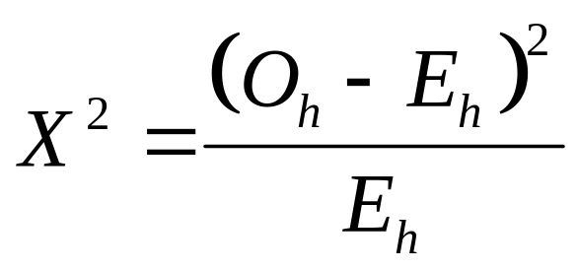
Measuring total discrepancy based on capture history frequencies
Different measures are available:
traditional chi-square test based upon observable capture histories h
parametric bootstrap GOF test (see MARK)
…

Slide 19
Limit of the tests of total discrepancy
technical limitations
  data too sparse for theoretical distribution to hold
  bootstrap may be too conservative (White 2002)
not informative in case of failure

Slide 20
A compromise: partitioning total discrepancy into meaningful components
for single-state CJS model (Burnham et al. 1987)
for multi-state JMV model (Pradel et al. 2005)
As yet, nothing available for state uncertainty

Slide 21
Optimal GOF test, CJS model
It is based on the CJS property that:
all animals present at the same date have equal future prospects
whatever their past capture history (→TEST 3)
whether they are currently captured or not (→TEST 2)

Slide 22
An optimal GOF test for CJS
CJS GOF test
TEST 3.SR
test of transience
TEST 2.CT
test of trap-dep
TEST 3.SM
TEST 2.CL

Slide 23
What is JMV?
JMV (Brownie et al. 1993) differs slightly from CAS (Schwarz et al., 1993)
It has a more general structure in capture prob.
p depends on site at t-1
Interest mainly theoretical

Slide 24
Optimal GOF test, JMV model
It is based on the JMV property that:
all animals present at the same date on the same site have equal future prospects
whatever their past capture history (→TEST 3G)
whether they are currently captured or not (→TEST M)

Slide 25
An optimal GOF test for JMV
JMV GOF test
TEST WBWA
test of memory
TEST M.ITEC
test of trap-dep
TEST 3G.SR
test of transience
TEST M.LTEC
TEST 3G.SM

Slide 26
Memory and TEST WBWA
In multisite studies, a likely violation of JMV assumptions is that individuals choose a site according to past experience.
TEST WBWA is designed to detect memory extending over an undeterminate number of time steps.
The memory models (Brownie et al. 1993; Rouan et al. 2009) allow movements to depend on the position occupied at t-1.

Slide 27
Memory and TEST WBWA
(Pradel et al. 2003)
Next seen
on site
Where After
Where Before
Test
1
2 . . .
Election of a familiar site
Election of a familiar site
Election of a familiar site
+
+
+
1
Last seen
on site
+
+
+
2
. . .

Slide 28
Results of TEST WBWA for the Canada goose data
occ site
2 1
2 2
2 3
3 1
3 2
3 3
4 1
4 2
4 3
5 1
5 2
5 3
sta pval df
19.59 0.000 2
37.87 0.000 2
4.49 0.034 1
80.59 0.000 1
98.76 0.000 4
0.81 0.369 1
27.71 0.000 1
53.69 0.000 2
25.29 0.000 1
43.66 0.000 1
50.93 0.000 2
29.48 0.000 2
-- Test WBWA -----
472.86 0.000 20
^
c = 23.6!

Slide 29
TEST M, a test of mixture
The first rows of the contingency tables must be tested for being independent mixtures of the last rows
36 18 0 13 6 0 6 5 1 5 2 0
36 158 2 22 92 3 7 32 2 3 2 1
11 30 18 3 10 10 0 8 3 2 5 3
491 134 0 149 71 3 51 42 3 21 13 0 159 869 15 63 335 10 41 164 3 18 74 2 14 101 158 8 47 48 7 16 18 1 14 11
mixtures
bases
First component of Test M for the Canada goose data
Complements about these GOF tests in Pradel et al. (2005)

Slide 30
General case
There is currently no general procedure for GOF of general multievent models
Use ad hoc approaches i.e. run available GOF tests on partial or simplified data
  e.g. recoveries alone, then recaptures alone
  e.g. remove the most unreliable events
  at the extreme, consider keeping only ‘seen’ and ‘not seen’

Slide 31
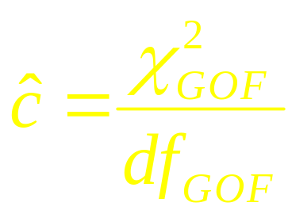
What to do when GOF tests are significant?
Account for specific sources of heterogeneity in model structure whenever possible
  transience
  trap-dependance
  memory
  heterogeneity of detection (test in Peron 2010)
Use a variance inflation factor to account for the remaining lack of fit as

Slide 32
Two-age-class models
If TEST 3.SR is significant, use a two-age-class model
(φ_{a.t},p_{t})
If TEST 3G.SR is significant, use
(φ_{a.f.t},ψ_{f.to.t},p_{f.t})

Slide 33
Optimal GOF test for the two age-class model (φ_{a.t},p_{t})
(φ_{a.t},p_{t}) GOF test
TEST 3.SR
test of transience
TEST 2.CT
test of trap-dep
TEST 3.SM
TEST 2.CL

Slide 34
Optimal GOF test for the two age-class model (φ_{a.f.t},ψ_{f.to.t},p_{t})
(φ_{a.f.t},ψ_{f.to.t},p_{t}) GOF test
TEST WBWA
test of memory
TEST M.ITEC
test of trap-dep
TEST 3G.SR
test of transience
TEST M.LTEC
TEST 3G.SM

Slide 35
Trap-dependence models
If TEST 2.CT is significant, use model
(φ_{t},p’_{t},p_{t})
If TEST M.ITEC is significant, use
(φ_{f.t},ψ_{f.to.t},p’_{f.t},p_{f.t})
where p’ is a specific capture prob. following a capture event
Note: trap-dependence models have serious identifiability problems in their general form.

Slide 36
Model (φ_{t},p’_{t},p_{t})
3 states:
  Trap aware (A)
  Not trap aware (U)
  Dead (†)
2 events:
  Not encountered (0)
  Encountered (1)

Slide 37
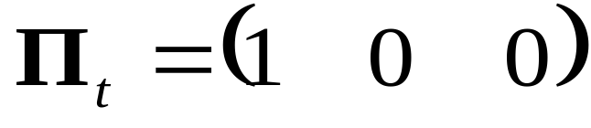
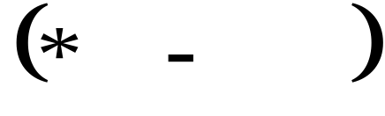
Model (φ_{t},p’_{t},p_{t}):
1.initial state probabilities
A U †
In GEPAT

Slide 38
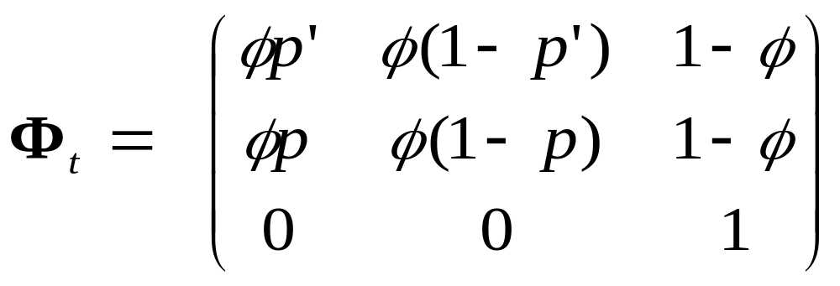
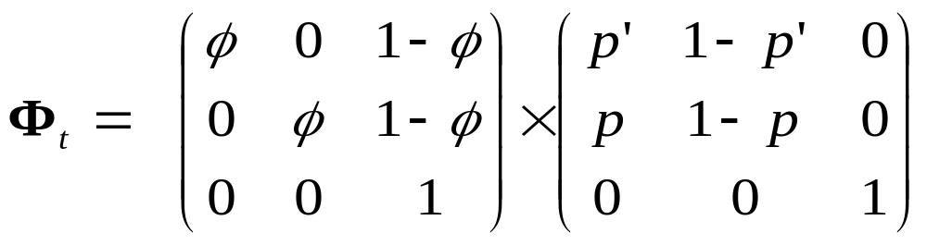
transition parameters
A U †
A
U
†
or in two steps
A U †
A U †
A
U
†

Slide 39
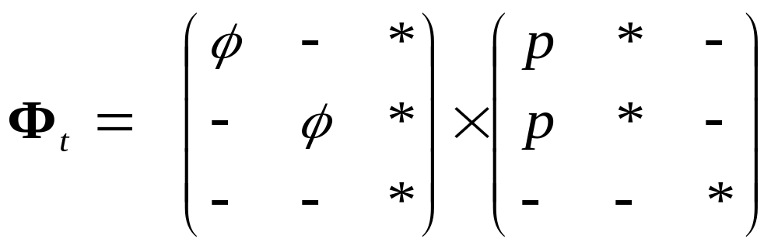
transition parameters
GEPAT
A U †
A
U
†

Slide 40
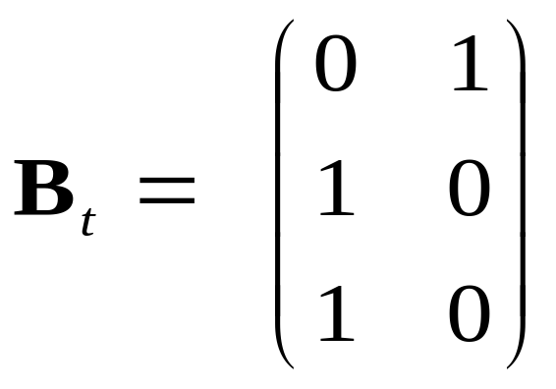
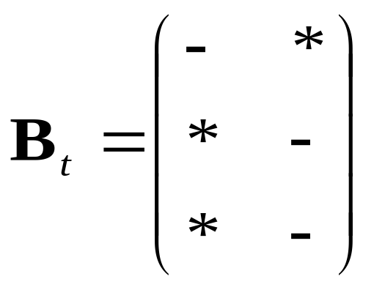
event parameters
A
U
†
GEPAT

Slide 41
Approximate GOF test for the trap-dependence model (φ_{t},p’_{t},p_{t})
(φ_{t},p’_{t},p_{t}) GOF test
TEST 3.SR
test of transience
TEST 2.CT
test of trap-dep
TEST 3.SM
TEST 2.CL

Slide 42
Model (φ_{f.t},ψ_{f.to.t},p’_{f.t},p_{f.t})
states:
  Live state 1 aware
  Live state 1 unaware
  Live state 2 aware
  Live state 2 unaware
  Dead (†)
events:
  Not encountered (0)
  encountered (1)

Slide 43
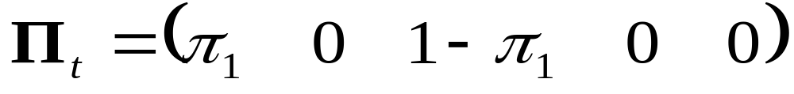
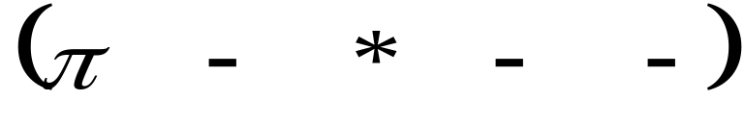
Model (φ_{f.t},ψ_{f.to.t},p’_{f.t},p_{f.t})
1.initial state probabilities
π₁ probability that a newly encountered individual is in state 1
A1 U1 A2 U2 †
In GEPAT

Slide 44
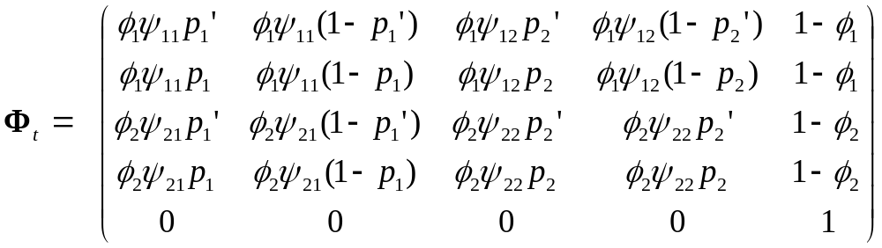
transition parameters
A1 U1 A2 U2 †
A1 U1 A2 U2 †
or equivalently (three steps)

Slide 45
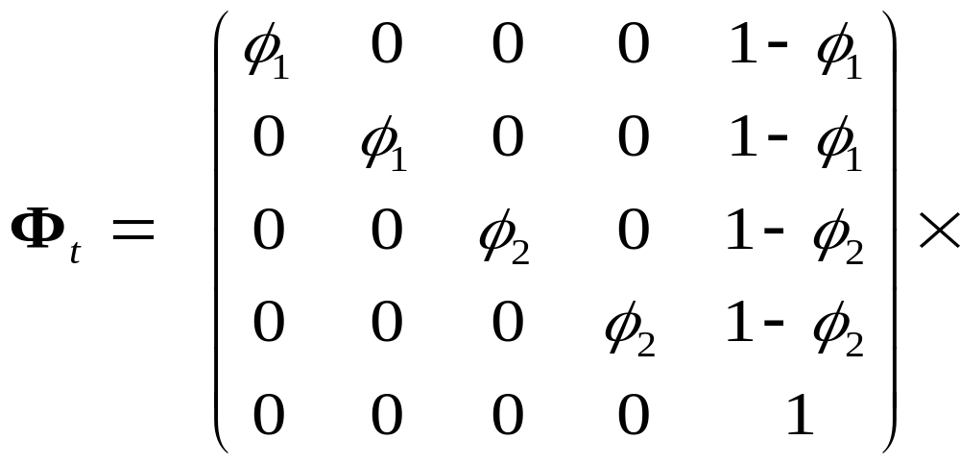
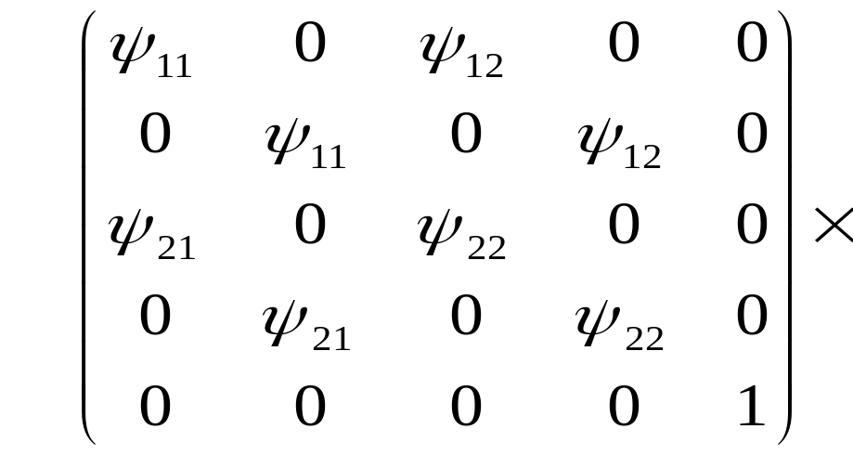
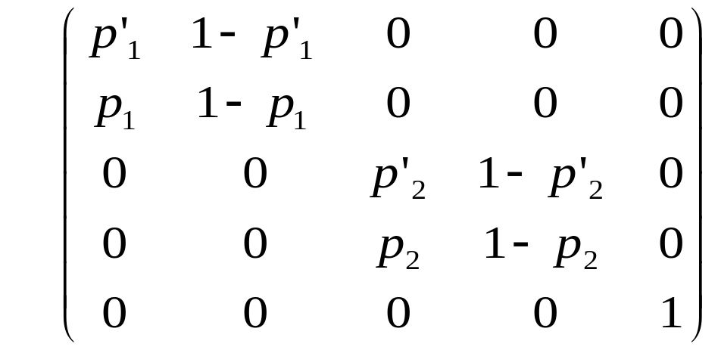
transition parameters
A1 U1 A2 U2 †
A1 U1 A2 U2 †
A1 U1 A2 U2 †
A1 U1 A2 U2 †
SURVIVAL STEP
STATE TRANSITION STEP
A1 U1 A2 U2 †
A1 U1 A2 U2 †
TRAP AWARENESS STEP

Slide 46
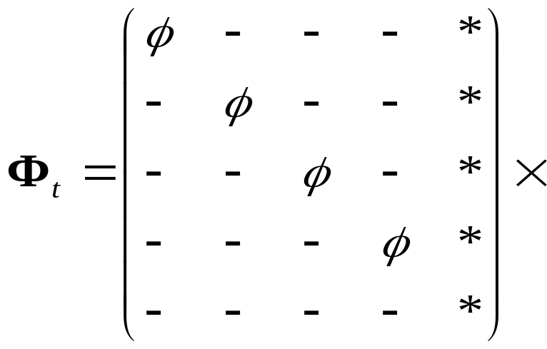
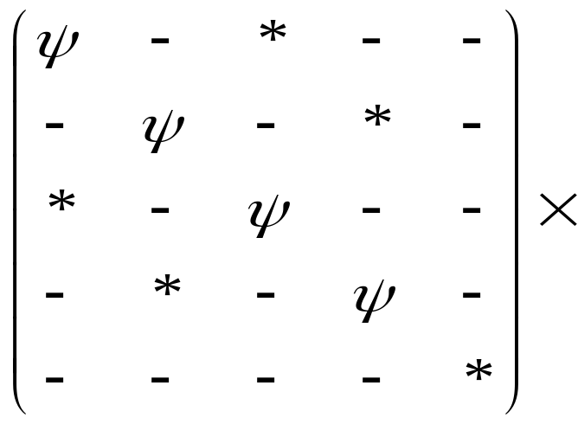
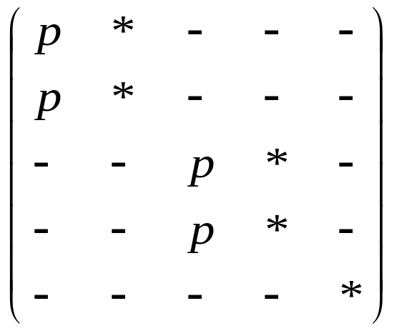
transition parameters
GEPAT
SURVIVAL STEP
TRANSITION STEP
CAPTURE STEP

Slide 47
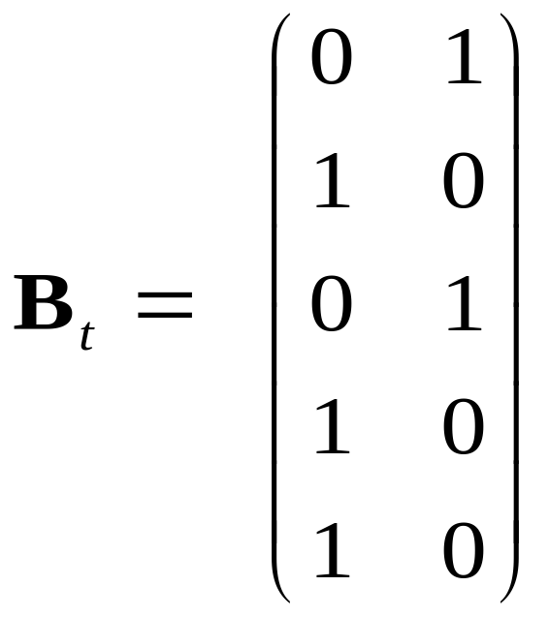
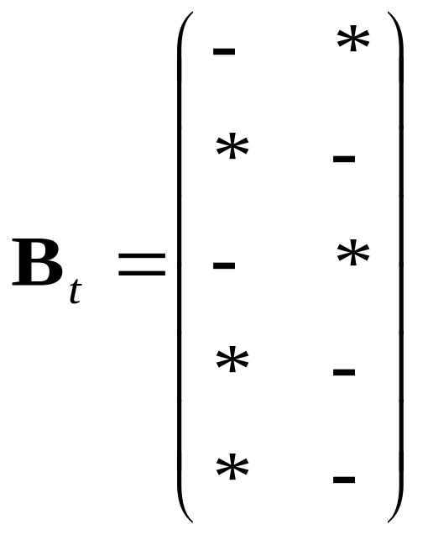
event parameters
A1 U1 A2 U2 †
GEPAT

Slide 48
Approximate GOF test for the trap-dependence model (φ_{f.t},ψ_{f.to.t},p’_{f.t},p_{f.t})
(φ_{f.t},ψ_{f.to.t},p’_{f.t},p_{f.t}) GOF test
TEST WBWA
test of memory
TEST M.ITEC
test of trap-dep
TEST 3G.SR
test of transience
TEST M.LTEC
TEST 3G.SM

Slide 49





Example: Canada geese
JMV GOF test
TEST WBWA
test of memory
TEST M.ITEC
test of trap-dep
TEST 3G.SR
test of transience
TEST M.LTEC
TEST 3G.SM

Slide 50
Memory model with two age-classes in survival
JMV GOF test
TEST WBWA
test of memory
variance inflation factor
TEST M.ITEC
test of trap-dep
TEST 3G.SR
test of transience
TEST M.LTEC
TEST 3G.SM

Slide 51
An approximate GOF test for CJS with heterogeneity
CJS GOF test
TEST 3.SR
test of transience
TEST 2.CT
test of trap-dep
capture heterogeneity
(test in Peron 2010)
TEST 3.SM
TEST 2.CL

Slide 52
Approximate GOF of Heterogeneity model
Wolf Genetical data (Cubaynes 2010)
Component overall df z² df overall-z² df
TEST 3.SR 23.7088 18 11.4989 1 12.2099 17
TEST 3.SM 5.5008 11 5.5008 11
TEST 2.CT 12.7559 22 3.4066 1 9.3493 20
TEST 2.CL 5.6759 12 5.6759 12
TOTAL 47.6414 63 14.9055 2 32.7359 61
X²/df 0.7558 7.4528 0.5367
although the test of CJS is OK, the component test of heterogeneity is strongly significant, prompting us to incorporate capture heterogeneity in the model

Slide 53
Wolf Genetical data
A summary of results with constant p
MODEL ESTIMATES
ϕ p π
Heterogeneity model (ϕ, p_{het}) 0.9182 0.0313 0.5623
0.5324 0.4377
CJS model (ϕ, p ) 0.8528 0.4325

Slide 54
U-CARE (Utilities for CApture-REcapture)
Input-Output CR files
Manipulation of data
Goodness of Fit for CJS and JMV

Slide 55
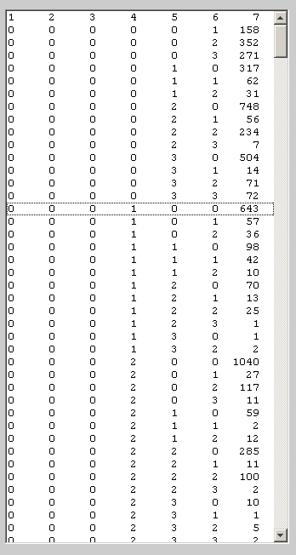
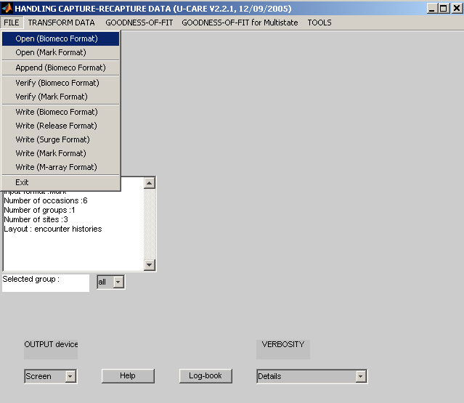
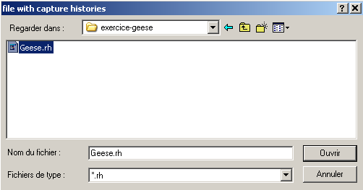
1. SELECT THE INPUT
FILE FORMAT
2. SELECT THE DATA SET
GEESE.RH
3. THE DATA APPEARS

Slide 56
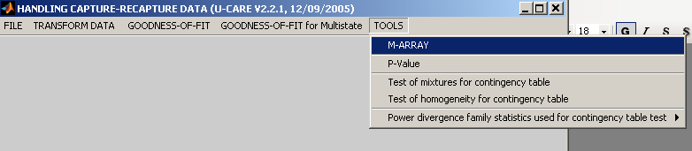
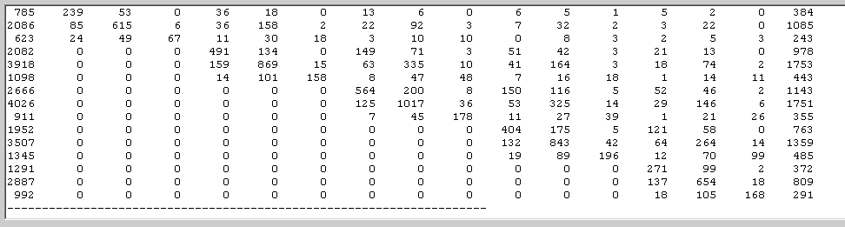
A SUMMARY : THE M-ARRAY

Slide 57
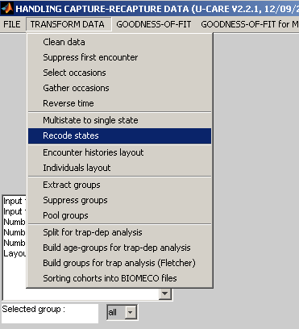
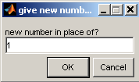
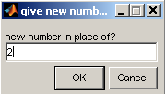
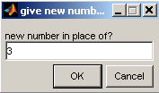
Manipulation of the data : put together sites 2 and 3
Select recode states
state 1 remains state 1
state 2 remains state 2
state 3 becomes state 2

Slide 58
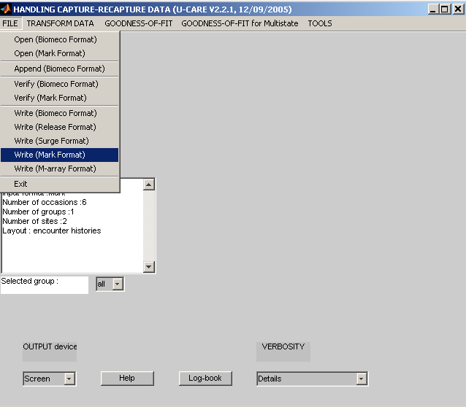
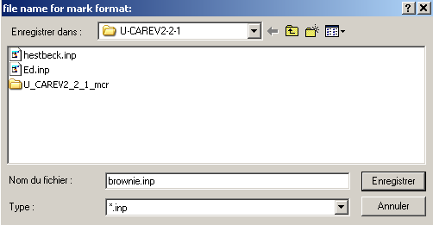
Save the new data
Call it brownie and click on save

